Slide 1




UBER DATA
ANALYSIS

Slide 2




OBJECTIVES
PCA
Linear
Regression
EDA

Slide 3





DATASETS
DATA 1
DATA 2
SHAPE
[ 196040 , 6 ]
SHAPE
[ 1156 , 7 ]
FARE_AMOUNT
CATEGORY
PICKUP_LONGITUDE
START
PICKUP_LATITUDE
STOP
DROPOFF_LONGITUDE
MILES
DROPOFF_LATITUDE
PURPOSE
PASSENGER_COUNT

Slide 4

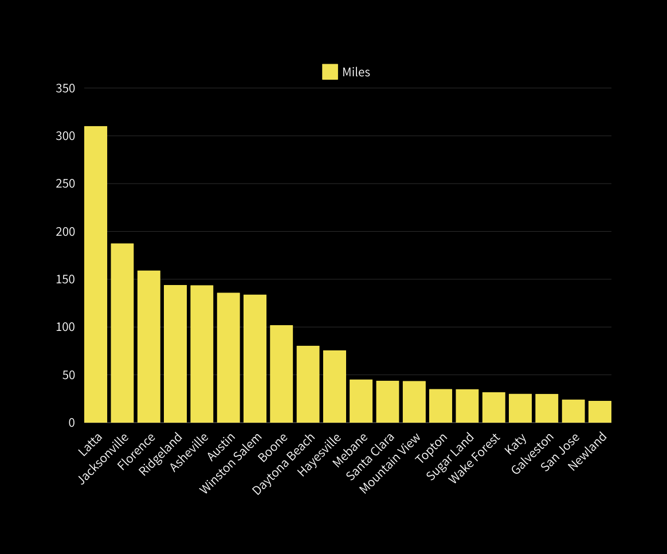

VISUALIZATION
310
188
159
144
144
136
134
102
81
76
45
44
44
35
35
32

Slide 5



VISUALIZATION
181
3.5
7.9%
15.0%
17.0%
66.7%
26
25.7%
16
15
2
11
10
8
6
5
4
16.7%
30.9%
16.7%

Slide 6
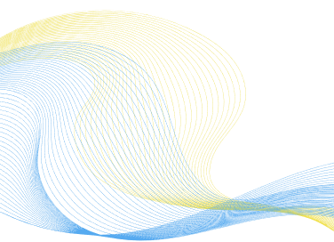
BARTLETT’S TEST OF SPHERICITY
(Adequacy Test)
HYPOTHESIS:
H0 : THE OBSERVED VARIABLES IN THE DATASET ARE NOT CORRELATED, AND THEREFORE, THE CORRELATION MATRIX IS AN IDENTITY MATRIX (SPHERICAL).
V/S
H1 : THE OBSERVED VARIABLES IN THE DATASET ARE CORRELATED, AND THE CORRELATION MATRIX IS NOT AN IDENTITY MATRIX (NON-SPHERICAL)
CHI SQ : 8.8817 P-VALUE : 1.0

Slide 7
KAISER-MEYER-OLKIN (KMO) TEST
HYPOTHESIS:
H0 : THE OBSERVED VARIABLES IN THE DATASET ARE NOT SUITABLE FOR STRUCTURE DETECTION, INDICATING THAT THE PARTIAL CORRELATIONS ARE CLOSE TO ZERO.
V/S
H1 : THE OBSERVED VARIABLES IN THE DATASET ARE SUITABLE FOR STRUCTURE DETECTION, INDICATING THAT THE PARTIAL CORRELATIONS ARE SIGNIFICANTLY DIFFERENT FROM ZERO.
KMO VALUE= 0.6128
KMO VALUE ABOVE 0.5 IS CONSIDERED MERITORIOUS FOR FACTOR ANALYSIS.

Slide 8

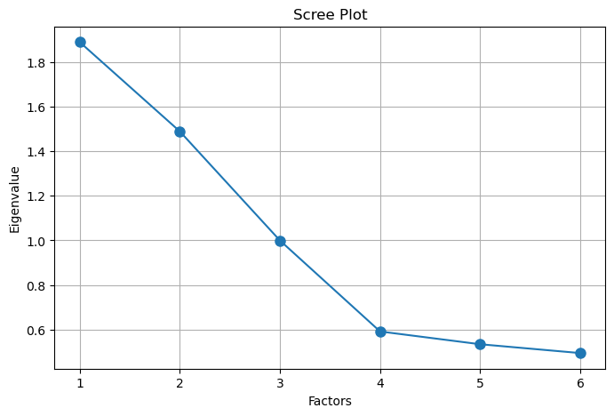
SCREE PLOT

Slide 9
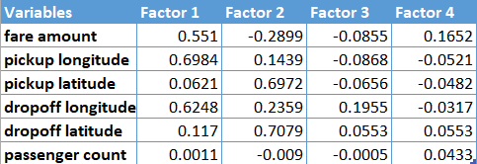
LOADING MATRIX

Slide 10

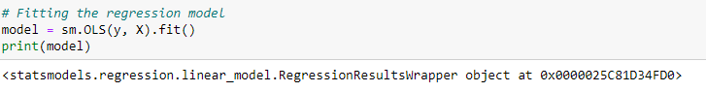
REGRESSION
X
Y
FARE
FARE AMOUNT
SERVICE 01
LONGITUD
LATITUDE
MODEL FITTING
SERVICE 04
LONGITUDE AT
DROPOFF
PASSANGER COUNT

Slide 11
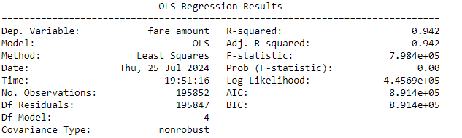
MODEL ACCURACY
41.39
MEAN SQUARED ERROR
94%
R-SQUARED

Slide 12
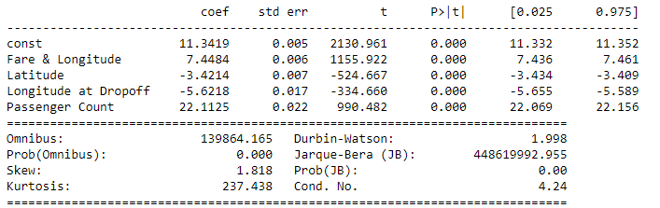
MODEL
INTERCEPT*11.34 + 7.44*FARE & LONGITUDE - 3.42*LATITUDE -5.62 * LONGITUDE AT DROPOFF + 22.11*PASSENGER COUNT

Slide 13
1. THE ANALYSIS OF TRIP DATA REVEALED THAT PICKUP AND DROPOFF LOCATIONS (LONGITUDE AND LATITUDE) ALONG WITH PASSENGER COUNT GREATLY IMPACT THE FARE PRICES.
2. By examining key factors like trip distance calculated from pickup and dropoff coordinates and the number of passengers, we gained insights into how these elements influence the fare amounts.
3. The predictive model utilized pickup and dropoff coordinates (Longitude, Latitude) in conjunction with the passenger count (X) to estimate the fare amount (Y), underlining these variables as crucial indicators of fare rates.
CONCLUSION

Slide 14

THANK YOU

